Slide 1
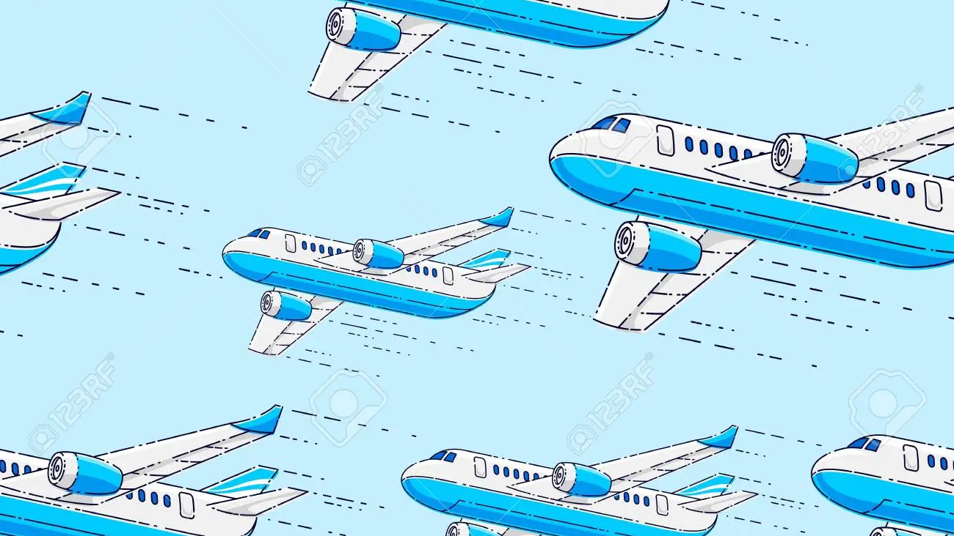
Flight price prediction
Under Faculty:
Mrs. Shweta Tiwaskar Ma’am

Slide 2

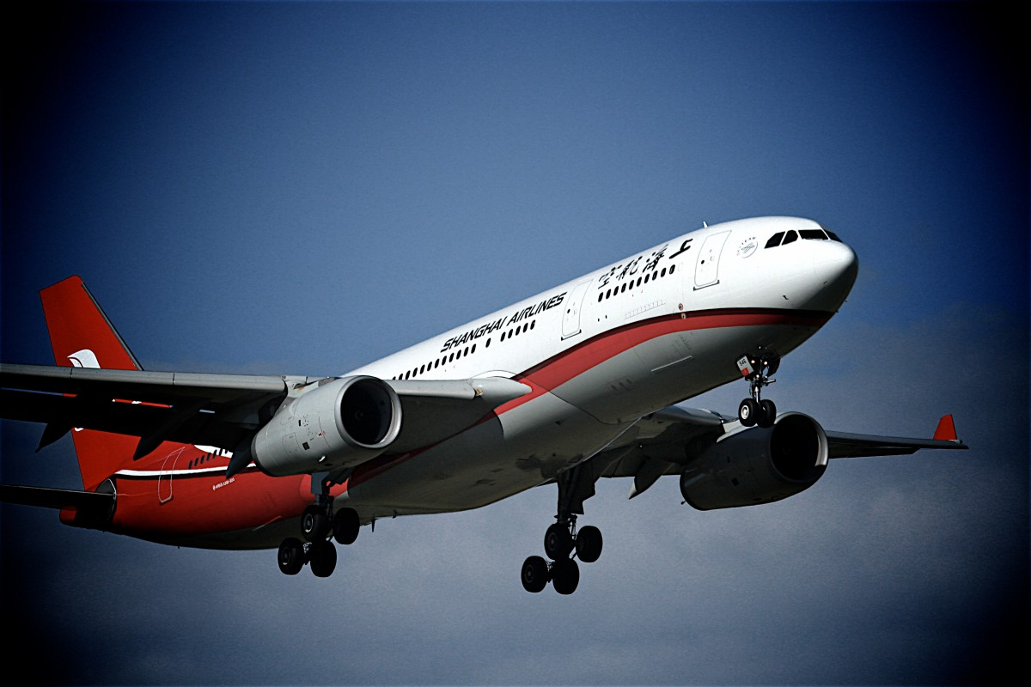
index
01 | Introduction
02 | Our Research
03 | Software Requirements
04 | Implementation
05 | Future Scope
06 | Conclusion

Slide 3

INTRODUCTION
In recent years, advances in data science and machine learning have led to the development of sophisticated prediction models. These models can help both service providers and users make more informed decisions and improve the overall usage experience.
We have combined our knowledge of the same to come up with this Flight Price Prediction Application.
This application makes use of the Linear Regression Model, implemented with python, to accurately predict ticket prices among a range of airlines sourced from a dataset.

Slide 4
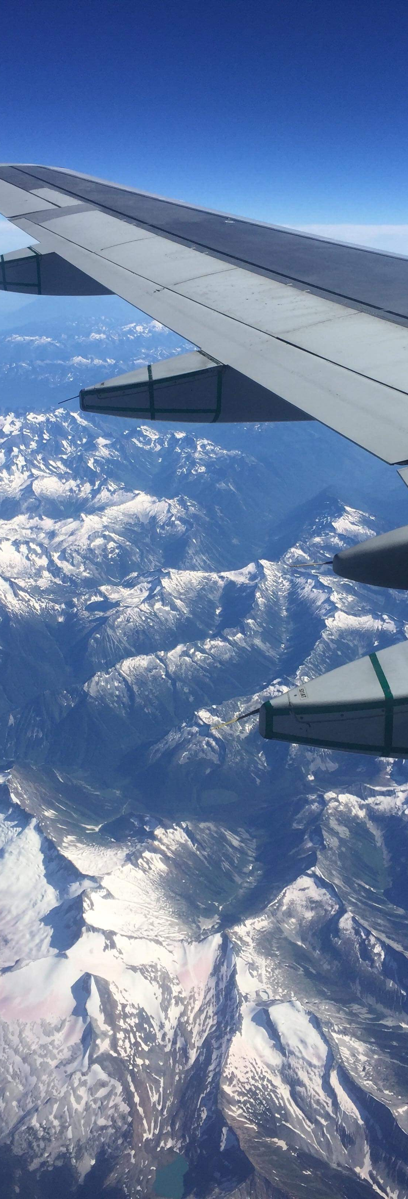

Our Research
Our research focused on providing prediction models for airline prices using ML techniques. Various attributes and airline companies were studied to predict flight prices. Categorizing flight prices into two divisions helped identify their impact on mean price. Airlines use pricing modes to manage offers and demand and increase profits. Data was gathered from various routes in India to analyze flight prices. ML models were used to anticipate travel pricing for different flights.
Booking tickets in advance can help avoid higher prices, but novice buyers may fall for discount scams set up by airlines.

Slide 5



software requirements
Operating system : Windows
Coding Language : Python
Editor : VScode

Slide 6
Implementation
The Project

Slide 7
further expansion
Expanding To Other Travel-related Industries:
Offering Predictive Analytics
Using Blockchain Technology:
Including More Factors
Our system can be adapted to other travel-related industries such as hotels, car rentals, and tour operators, to provide a more comprehensive travel planning experience for customers.
We can offer predictive analytics to travel agencies and airlines to help them make better business decisions based on our predictions.
We can use blockchain technology to enhance the security and transparency of our system and to enable secure transactions between customers and airlines/travel agencies.
We can include more factors such as customer demographics, travel patterns, and customer preferences to make the predictions more personalized and tailored to individual customers

Slide 8
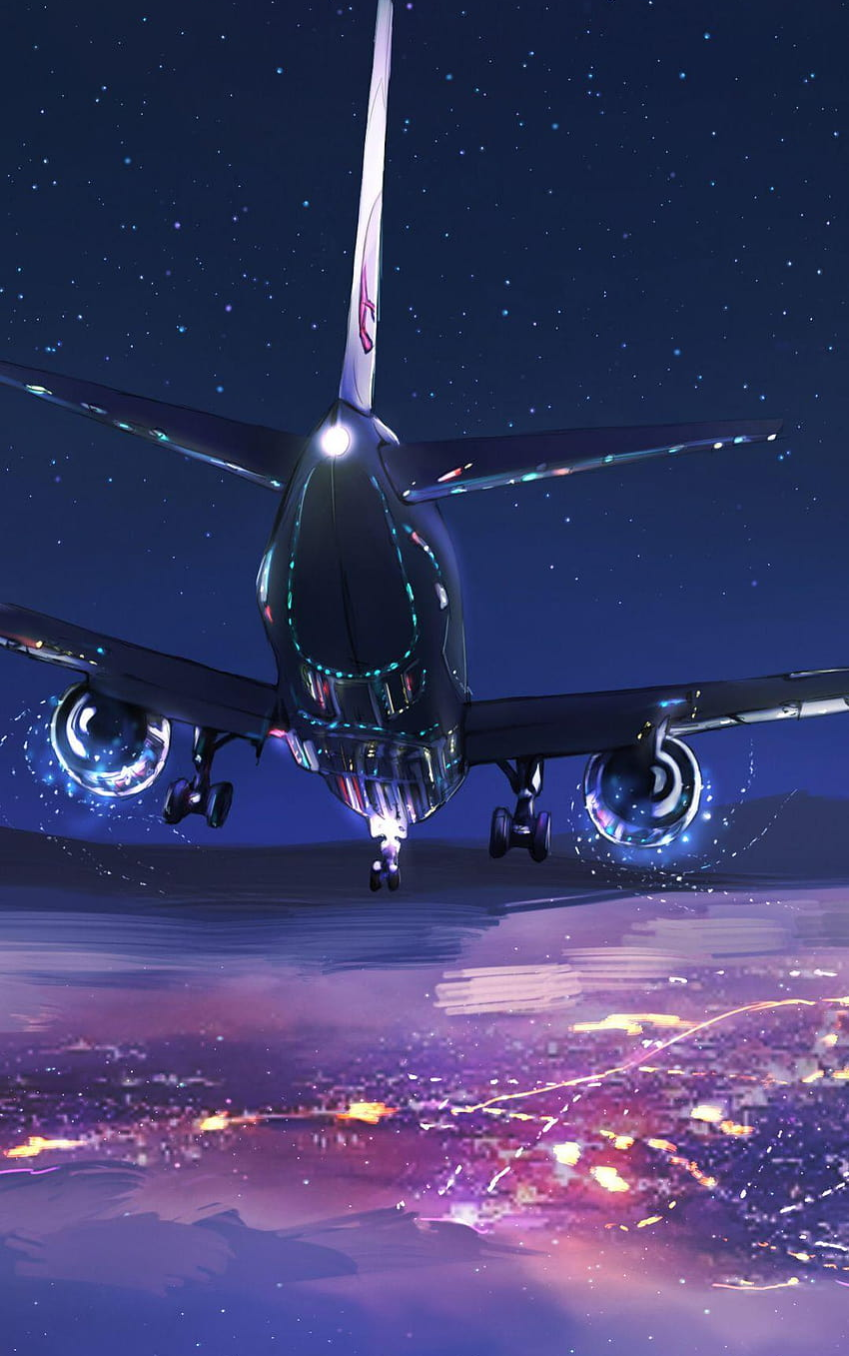
Conclusion
Our flight price prediction project aims to provide accurate and personalized pricing information to customers by gathering data from multiple sources and analyzing it using machine learning techniques. We understand that flight prices are constantly changing and can be influenced by various factors such as demand, seasonality, competition, fuel costs, and weather conditions. Therefore, we have designed our system to adapt to changing circumstances and provide real-time updates to customers. Our goal is to improve the customer experience while also increasing revenue for airlines and travel companies.

Slide 9


The TEAM
Sanghamitra Janrao
222056​
22111231
​
Dhanashri Mahale​
222072​
22220088​
​
Shruti Kamble​
222075​
22220169​
​
Muskan Shaikh​
222078​
22220287​
​

Slide 10

THANK
Email IDs:
shruti.22220169@viit.ac.in
dhanashree.22220088@viit.ac.in
muskan.22220287@viit.ac.in
kundan.22111231@viit.ac.in
You

